Slide 1
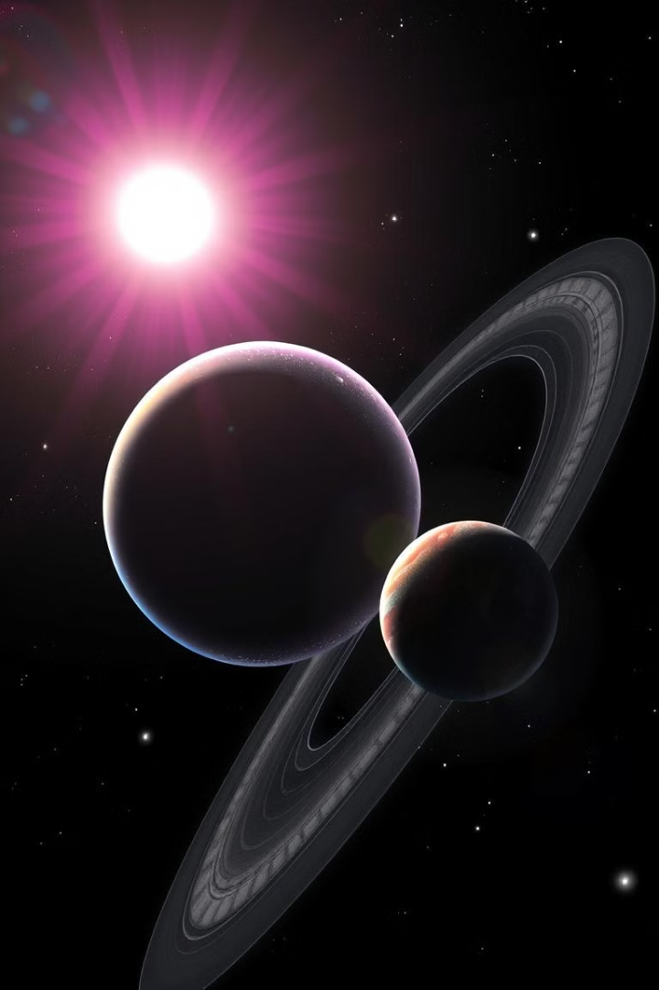
Mixed Reality Solar System
The Mixed Reality Solar System application immerses users in a captivating 3D environment by using Unity and MRTK for Hololens. The app allows them to explore the planets and learn about the solar system in an engaging way.
SG
by Sarthak Goel

Slide 2

Overview of Unity and MRTK for Hololens
Unity Engine
MRTK (Mixed Reality Toolkit)
Unity provides a powerful and versatile platform for developing mixed reality experiences.
MRTK simplifies mixed reality development by providing a comprehensive set of tools and components specifically designed for Hololens.

Slide 3
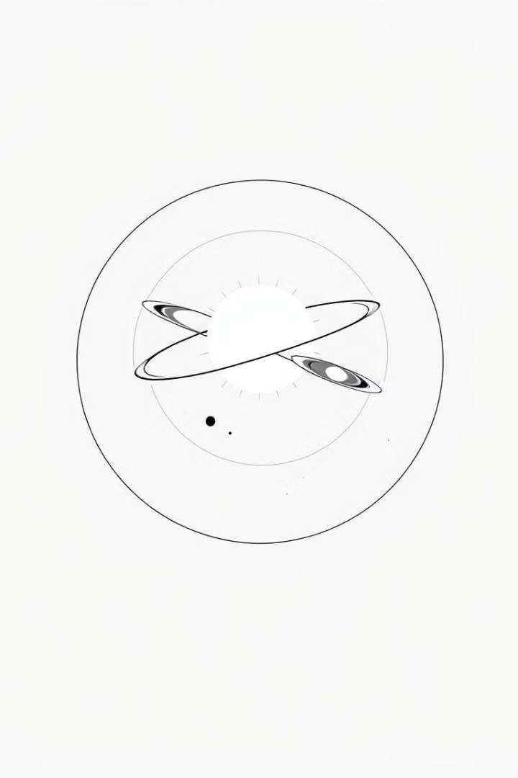

Designing the 3D Solar System Model
1
Planet Modeling
Detailed 3D models are used for each planet in the solar system.
2
Texture and Material Application
Realistic textures and materials are applied to the models, ensuring visual accuracy.
3
Orbital Path Simulation
Accurate orbital paths are implemented for each planet, ensuring realistic motion.

Slide 4
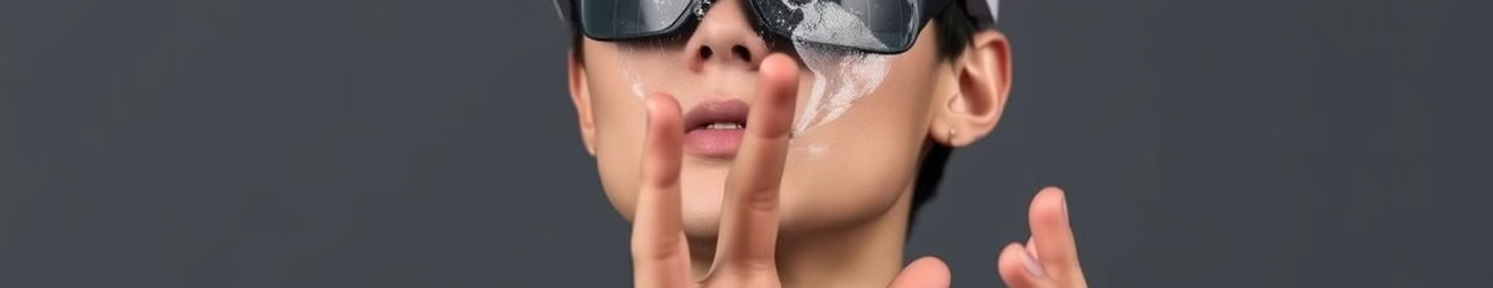
Implementing User Interaction with MRTK
1
Hand Tracking
2
Gaze Input
3
Far interacions
MRTK's hand tracking features allow users to interact with the solar system using natural gestures.
Users can select and interact with objects by looking at them, providing a seamless user experience.
Users point a ray attached to the hand and select objects by pressing index and thumb tips together

Slide 5
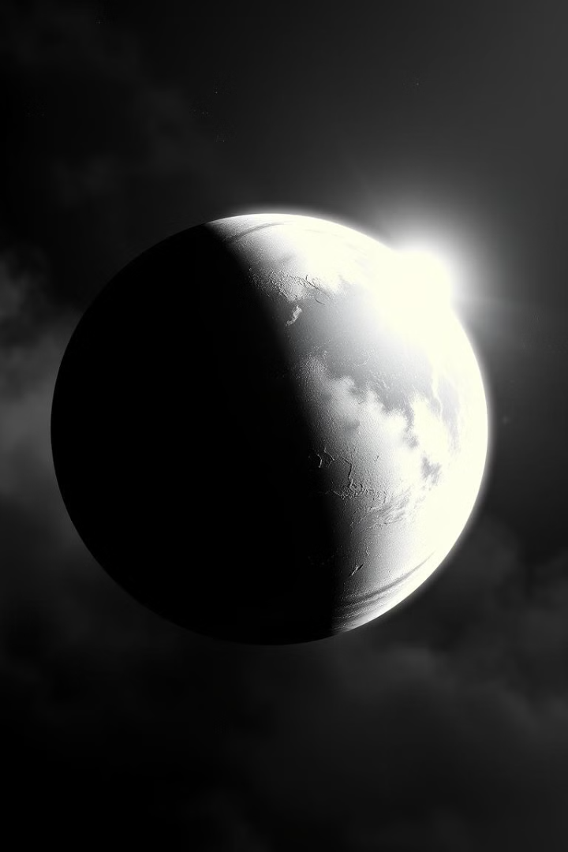




Lighting and Visual Effects in the Mixed Reality Scene
Realistic Lighting
Accurate lighting conditions simulate the sun's influence on planets.
Milky Way Galaxy Skybox
A realistic Milky Way galaxy skybox enhances the visual immersion and sense of scale.
Visual Orbits
The scene includes Purple colored orbits to visually represent the pathways of these celestial objects.

Slide 6
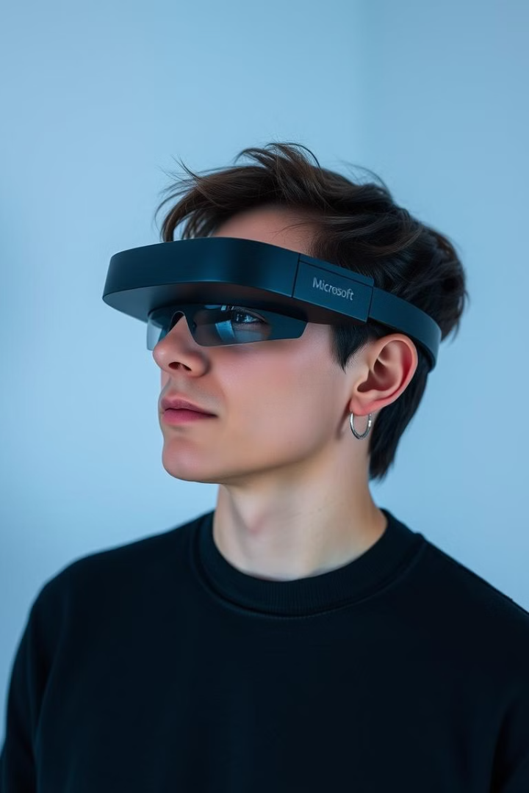
Deployment and Accessibility on Hololens
Optimization
Deployment
The application is optimized for Hololens, ensuring smooth performance and optimal user experience.
The application is packaged and deployed to the Hololens using Unity's built-in tools and Microsoft's deployment methods.

Slide 7
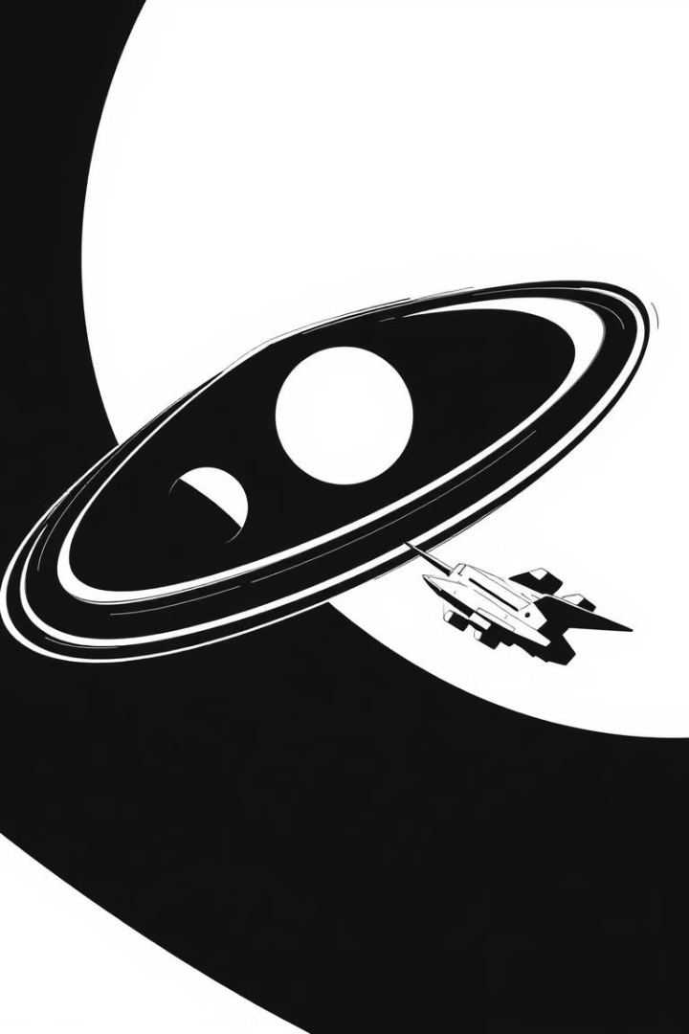
Conclusion and Future Enhancements
This mixed reality solar system application holds immense potential for further development and expansion. The incorporation of interactive exploration tools, multiplayer capabilities, and expanded educational content will undoubtedly enhance the user experience and learning opportunities.

